Slide 1

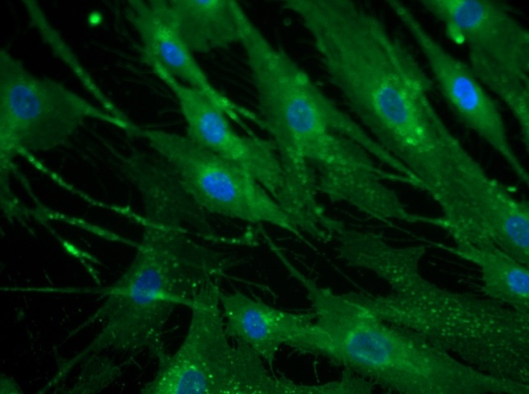
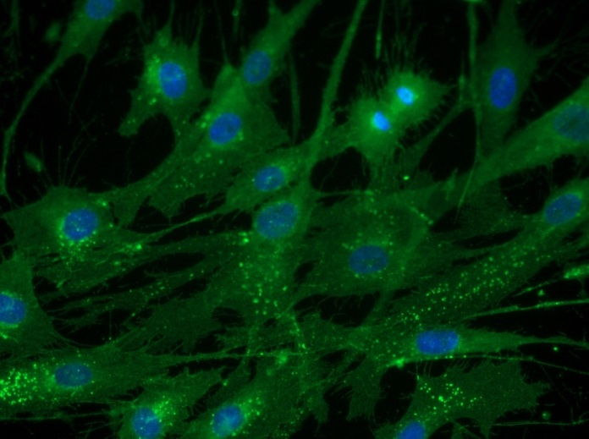
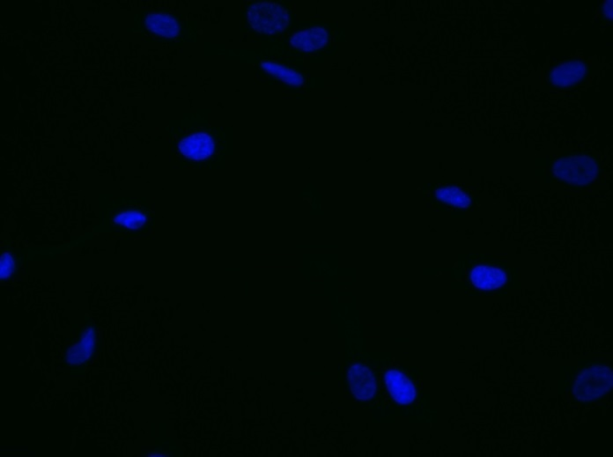
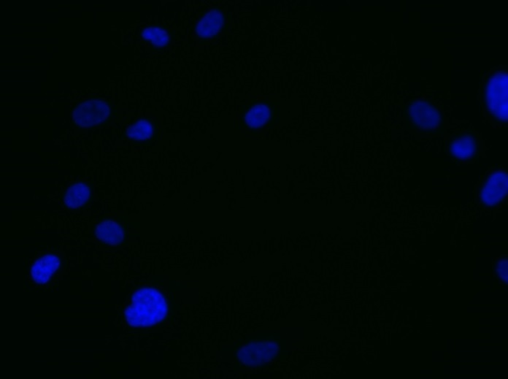
Reliatech GmbH
Mouse anti-human Neuropilin-1 (NRP-1)
(Cat# 102-PA23AG [5 µg/ml]; NHDF)
Immunofluorescence staining of human Neuropilin-1 (NRP-1) (#102-PA23AG) in primary normal human fibroblasts (NHDF) using a polyclonal antibody directed against the extracellular domain of human NRP-1.
As secondary antibody goat anti-rabbit ALEXA Flour 488 (Dianova; 1:600) was used.
[IF_LEC1406-01]
.
rabbit anti-human NRP-1
rabbit anti-human NRP-1
Control (goat anti-rabbit IgG ALEXA Flour 488; 1:600)
http://www.reliatech.de / orders@reliatech.de

